Slide 1
PANIMALAR ENGINEERING COLLEGE DEPARTMENT OF CSE
SOCIALLY RELEVANT MINI PROJECT
RETROFIT
USER FRIENDLY FITNESS TRACKER
BY
LEO ASHWIN V (211422104249)
MOHAMED TARIQ ALI S(211422104278)
III CSE - G

Slide 2
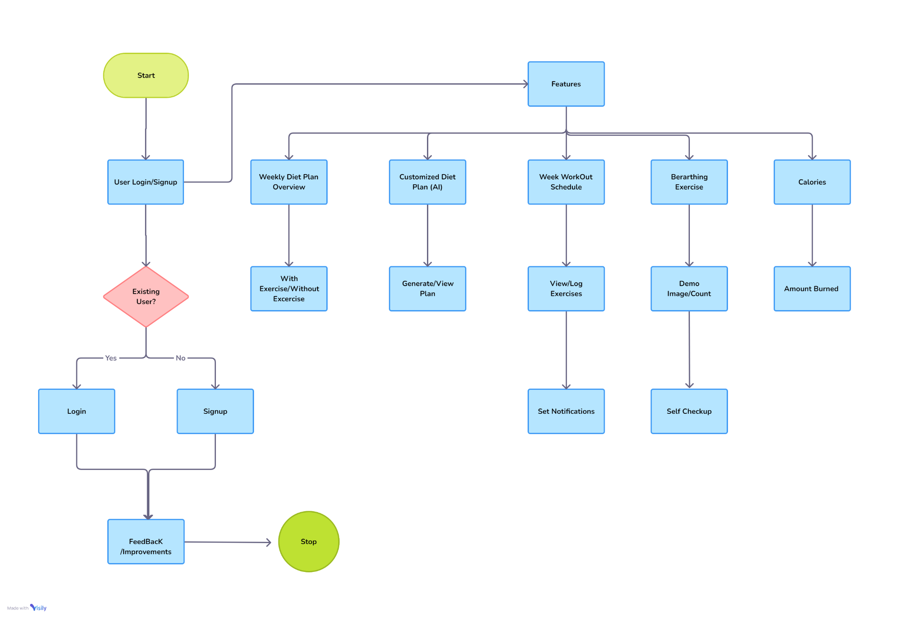
ARCHITECTURE DIAGRAM

Slide 3
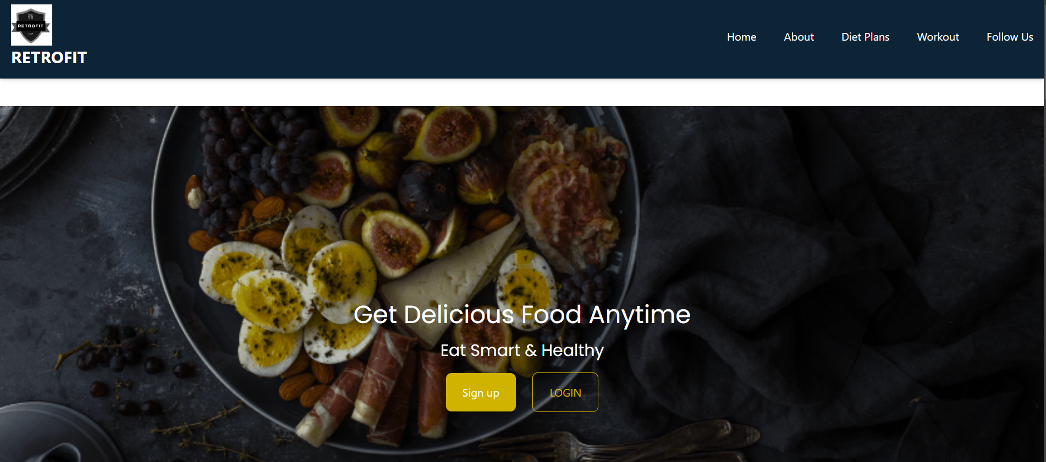
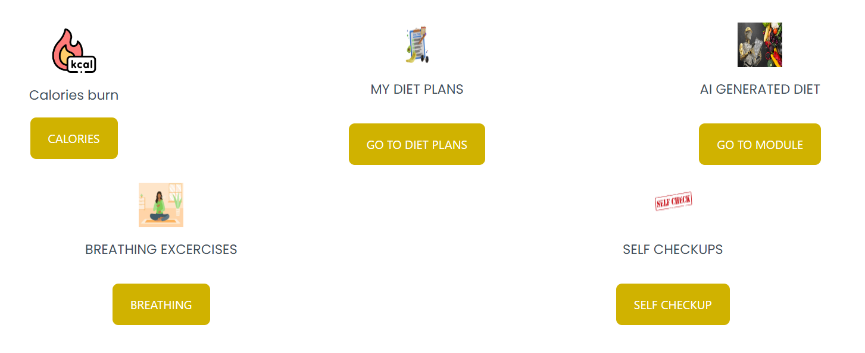
BASIC UI INTERFACE

Slide 4
METHODOLOGIES
1. Requirement Gathering and Analysis
- User Research: Understand the target audience's preferences and expectations for diet plans, exercise , and self-checkup features. This helps in defining the core functionalities.
- Feature Prioritization: Based on user feedback and research, prioritize features such as weekly diet plans, AI-based customization, exercise tracking, calorie tracking, and self-checkup with breathing medications.
2. System Design
- Architectural Design: Design a system architecture that includes a basic user interface (UI) and a minimal database to store login credentials and feedback.
- AI Integration for Diet Plans: Plan the integration of an AI module that allows users to customize diet plans based on their preferences, health conditions, and fitness goals. Ensure scalability to personalize user experiences effectively.
- Database Design: Design a lightweight database that stores user login credentials and feedback details. No complex data structures are needed since the system will not handle continuous monitoring.

Slide 5
METHODOLOGIES
3. Frontend Development
- Design: Develop a user-friendly interface where users can view weekly diet plans, customize them using AI, log exercises, and calories burned.
- Responsive Design: Ensure the website is mobile-responsive, allowing users to access features like diet plans, exercise logging, and self-checkup from any device.
- Exercise Notifications: Implement notifications that remind users of their logged exercises and track progress through dashboards.
4. Backend Development
- AI Diet Customization: Develop an AI algorithm or integrate a third-party AI service to provide diet suggestions based on user preferences and health goals.
- Details- Login and feedback details are stored in the databases for references for next signup and any improvements in future.

Slide 6
NEW TOOLS
System Design:
Visily(Architectural Diagram)
BigDev(Prototype)
Fonts and Styles
Google fonts
Tailwind css
Icons and Images:
Iconify
Imagekit
Auditing:
SeoMator
Hosting:
Vercel
Netlify

